Slide 1

Team Details and Problem Statement
Organization Name : National Technical Research Organisation,(NTRO)
PS Code: SIH1456
Problem Statement Title: Speech to text transcription for Indian languages. The problem entails transcription in the native script and then translation to English. The languages of interest are Hindi, Indian English, Urdu, Bengali, Punjabi.
Team Name: TECH NATIVES
Team Leader Name: Sudesh Bansode
Institute Code (AISHE): C-42143
Institute Name: PVG's College of Engineering and Technology
Theme Name: Miscellaneous

Slide 2
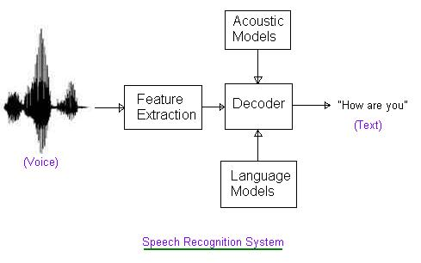
Idea/Approach Details
Data Preprocessing : Convert the audio files into text using Automatic Speech Recognition (ASR) systems tailored for each language.
Translation Models : Train or find machine translation models for each language pair (e.g., Hindi to English, Urdu to English) using the training data.
Accent Adaptation:: Consider accent adaptation techniques to improve the accuracy of the ASR and translation models for Indian accents.
Post-processing:: Implement post-processing techniques to further improve the accuracy of the generated translations. This might include grammar correction, spell-checking, and punctuation normalization.
Deployment: Deploy the trained models in a production environment, which could be a web application or an API, depending on our requirements.
Technology stack:
Python speech recognition module:
‘speechrecognition’ and ‘pyaudio’ library
Google cloud text to speech API i.e. ‘google-cloud-speech’ lib
Python translation module:
Using Python module ‘translate’
Using Python module ‘googletrans’
Python text to speech module:
Using Python library ‘gTTS’(Google Text-to-Speech) with language as ‘en-in’
Using ‘AWS SDK’(Amazon Web Services Software Development Kit) for Python ‘boto3’.

Slide 3
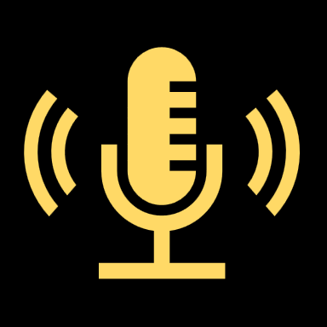



From understanding to Development : The Process
FLOWCHART
Applications
Business: This AI tool can be used by businesses to translate and transcribe customer support tickets, marketing materials, and other business documents into multiple languages.
Education: This AI tool can be used in educational settings to help students learn new languages and to transcribe lectures and other learning materials. This makes education more accessible to students from all over the world.
Media and entertainment: Our AI tool are being used in the media and entertainment industry to translate and subtitle movies, TV shows, and other video content. This makes these forms of entertainment more accessible to people who speak different languages.
Government: Government agencies are using AI translation and transcription tools to translate official documents, translate public service announcements, and transcribe meetings and other events. This helps them to communicate more effectively with the public and to provide better services.
Healthcare: Our AI tool can be used in healthcare settings to translate patient records, translate medical consultations, and transcribe medical lectures and conferences. This helps to improve communication between healthcare providers and patients and to ensure that patients receive the best possible care.
Travel and tourism: AI translation and transcription tools can be used by travelers to translate menus, signs, and other materials into their native language. This can help them to communicate more effectively with locals and to have a more enjoyable travel experience.
Personal use: AI translation and transcription tools can be used for a variety of personal purposes, such as translating foreign language books and articles, transcribing personal notes and recordings, and communicating with friends and family who speak different languages.
Use of speech recognition libraries so that system identifies the spoken content
Display a drop down for the user to select the input language
Audio input of the content to be translated to the system
Transcribing the audio content to text format.
Outputting the translation in audio format
Use of python libraries like ‘PyAudio’ for transcription
Displaying the English translation
Translation of the generated text output to English language

Slide 4
Idea/Approach Details
Show stopper :
Advantages :
Different accent based on regions may cause problems to identify the exact speech and decrease accuracy.
Voice with very low or very high pitch may also cause problems during speech recognition.
Homophones(words that sound same but are different in meaning and spelling) may decrease the accuracy of the software.
It will be difficult to obtain final translated text grammatically correct and with accurate punctuations.
Every sentence spoken have different context so ai tool cannot actually transcribe and translate with same context.
Word error rate (WER) is a common metric used to measure the performance of speech recognition systems. It is calculated by comparing the output of a speech recognition system to a reference transcript of the spoken words
.
Helpful in translation of native languages into English which will help other people interact with the locals.
The natives can get access to English language and learn new English words corresponding to their local language.
The use of Indian accent will be more convenient and easy to understand for Indians.
The audio file transcription to native script and its further translation to English language will be done together. Hence, saving time and increasing efficiency.
Transcription of audio files to native script will also help in educating native speakers to learn and write in their own language.

Slide 5
Team Member Details
Team Leader Name: Sudesh Bansode
Branch : BE Stream : IT Year : II
Team Member 1 Name: Unmesh Kapure
Branch : BE Stream : IT Year : II
Team Member 2 Name: Aditya Shirwalkar
Branch : BE Stream : CS Year : II
Team Member 3 Name: Jay Joshi
Branch : BE Stream : CS Year : II
Team Member 4 Name: Ketaki Deo
Branch : BE Stream : CS Year : II
Team Member 5 Name: Chaitra Moghe
Branch : BE Stream : CS Year : II

